Slide 1
Student Assist System

Slide 2
Motivation
A reputed university is developing a system for the benefits of students to get connected with seniors for study related information and acts as a single source for all needed information when they are on boarding for the first year.
Seniors can enrol themselves for this program and volunteer to provide information to new students.
New student can choose to connect with seniors through social media upon senior’s consent.

Slide 3
Team Members
Table:-20
1.Pooja Sree Edula
2.Narra Neelima
3.Spoorthy pallempati
4.Sruthi
5.Yadiki Neha
6.Yammanuru Gowthami

Slide 4
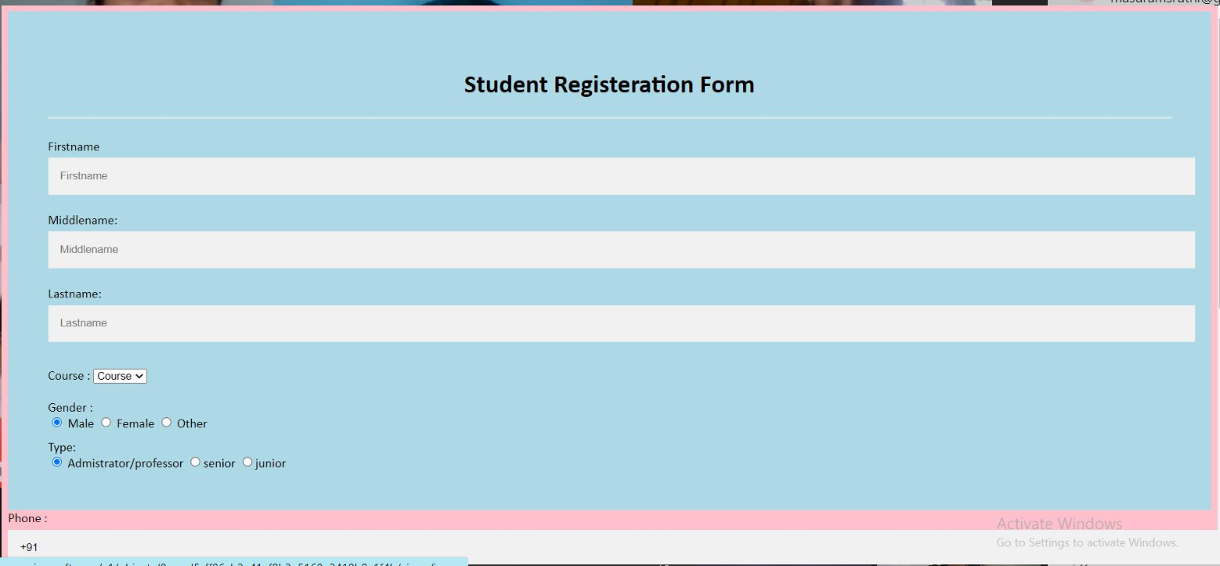
Github location :-https://github.com/YadikiNeha/Student-Asist-System

Slide 5
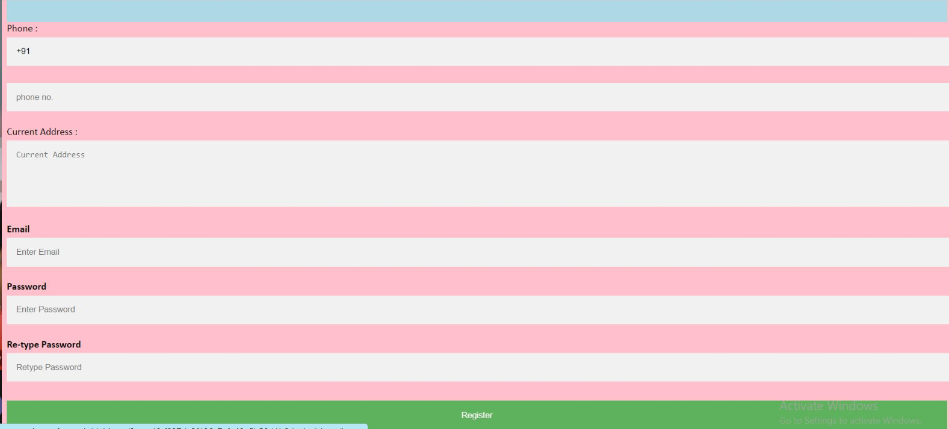

Slide 6
Thank you

Slide 7
